Slide 1

Finding Wind And Solar Energy For Suitable Regions
——————————————————————————————
https://github.com/xxxxxx/xxxxxx
UN Big Data Hackathon
Track 8-11 November 2022

Slide 2
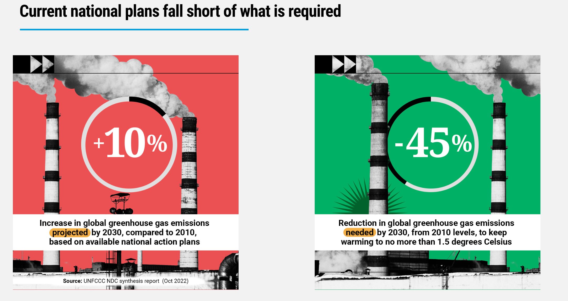
Project Background
Why We Designed This Project？
Despite the unanimous adoption of the 'Transforming our World: The 2030 Agenda for Sustainable Development' in 2015, it now appears unattainable, with some indications of worsening instead of improvement

Slide 3

Design Approach
Design Approach
By tapping into the potential for new energy generation in certain regions, we aim to gradually replace the dominant position of traditional energy sources, taking a further step towards net-zero emissions by 2050.

Slide 4
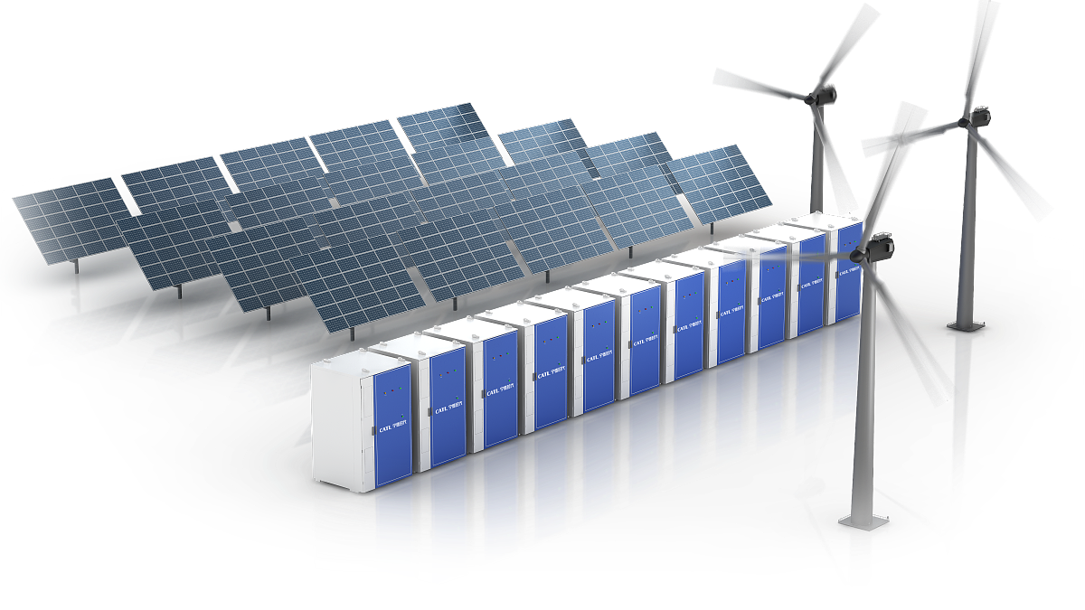
Design Objectives
Using publicly available data and models based on various parameters to find suitable clean energy sources for specific regions.

Slide 5


Challenges
Data level
Model level
Global power station data：
Global natural data such as wind speed, solar radiation,temperature
Population data, economic data, electricity usage data of countries and their regions
Nighttime illumination data, and so on
Can we integrate large-scale models?
Are there options for creating effective machine learning models or expert models?

Slide 6

Implementation Status
Current Status
In practice, only NASA's climate data, which includes temperature, precipitation, sunlight, wind speed, and atmospheric pressure data, have been integrated to develop an initial expert model. This model can provide a basic forecast of whether the target region has the potential for photovoltaic or wind power generation.

Slide 7
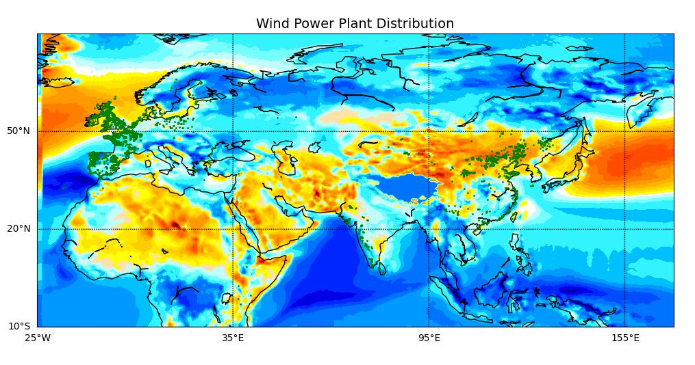
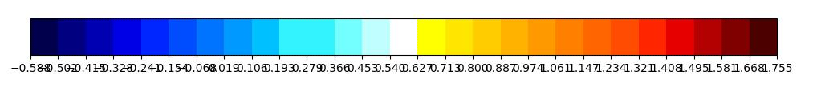
Result

Slide 8
Thank You!
汇报人：陆仁贾
时间：2023年11月6日

